Slide 1
Chapter 3
Physics by HRK V1 5th Ed.
Topic nos. differ as the material is taken from an FoP by HRW 10th Ed. &
Physics for Scintists. & Engrs. By Serway & Jewett 9th Ed.
Newton’s Laws
(Selected Topics)
By
Zuhoor Elahi

Slide 2
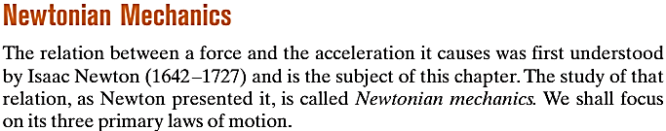

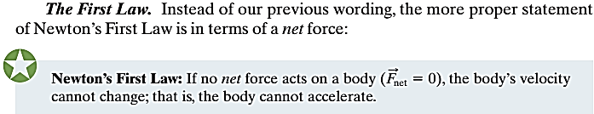
Newton’s Laws of Motion

Slide 3
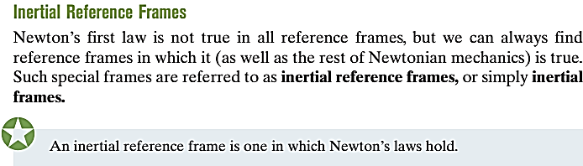
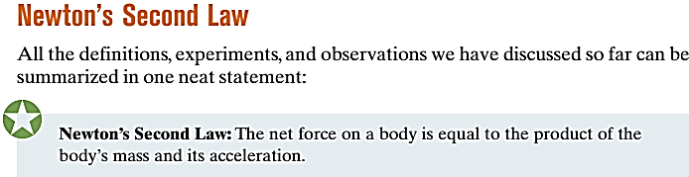

Newton’s Laws of Motion

Slide 4


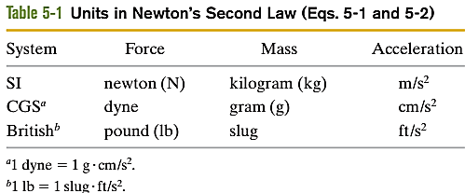
Newton’s Laws of Motion

Slide 5
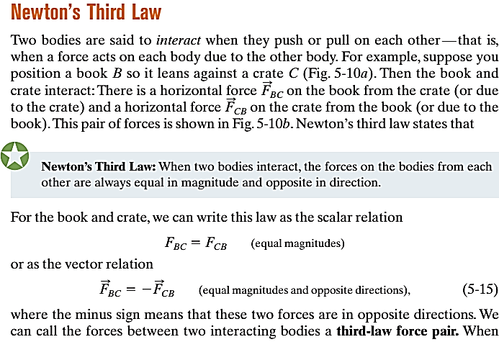
Newton’s Laws of Motion

Slide 6
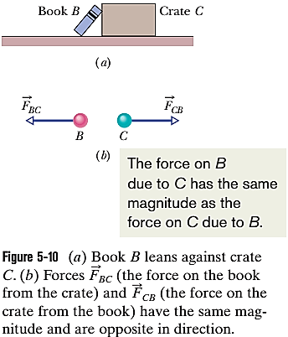
Newton’s Laws of Motion

Slide 7


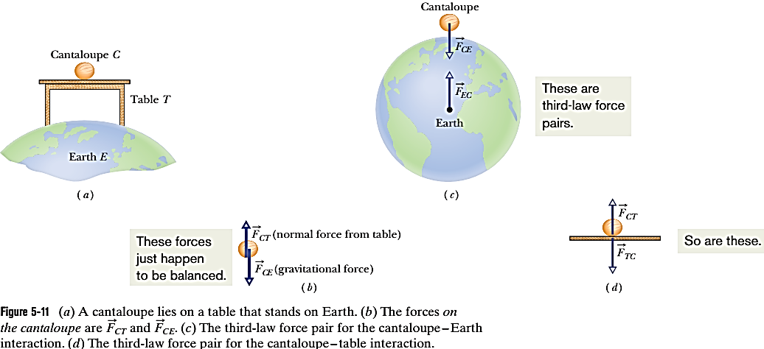
Newton’s Laws of Motion

Slide 8
